Slide 1
Laravel

Slide 2
Introduction
What is Laravel ?
Php Framework
To develop web app and API
Create complex web applications
What is Framework ?
Framework is Programming Tool that Provides ready-made functions , features for development.
Common structure already Created .
Features Like
Routing
Easy database Connection
Ready Made Functions for session
Helper for commonly used functions

Slide 3
The difference in Laravel and fw (react , angular etc.)
Laravel
React and Angular etc.
Laravel is a server side framework.
Code execute server-side not browser side.
You cannot make a single page application
No Direct Database connectivity.
Needs API
Need Backend framework.
Create single page applications

Slide 4
What is MVC
MVC basically is a Architecture
MVC (Model View Controller)
MVC is a pattern in software design commonly used to implement user interfaces data and controlling logic

Slide 5
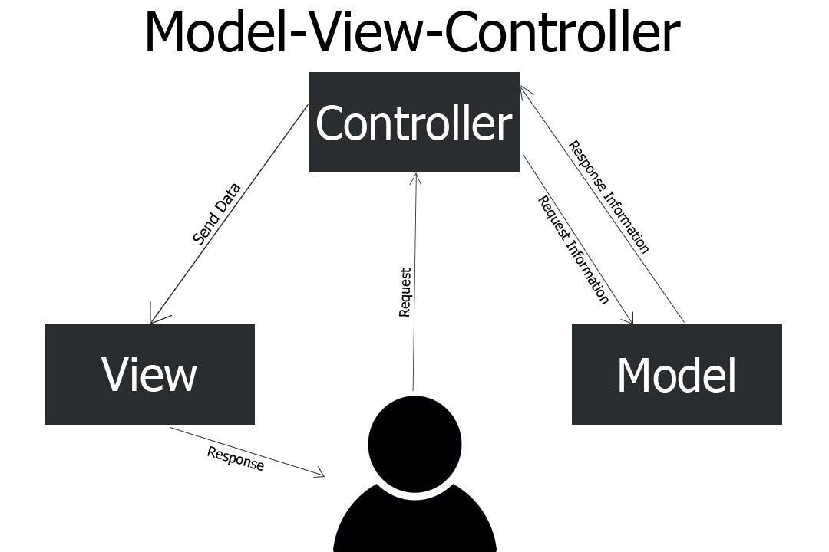
MVC
Model
Manage and handle Data , database and business logics.
View
Handle layout and display. (HTML Part)
Controller
Routes
Get request from user and control Model and view

Slide 6
installation
Download xampp
Composer
Dependency manager for PHP
Install – packages with single command.
Similar like NPM in node
Steps
Install Composer (Once)
getcomposer.org
Install Laravel (once)
Make a Project And Run

Slide 7
Install Laravel and app
Check composer is install
Install Laravel Globally
composer global require laravel/installer
Install Laravel App
laravel new example-app
Start the app
cd example-app
php artisan serve

Slide 8
Folder structure
App => kernel file => create new commands
Exceptions => Handler => run time error
Http => Controller = Interact Model and view AND Middleware => Guard => Who’s Access Files or a folders kernel.php => Models register in this kernel file
Models => Database connection files
Bootstrap => app => load application , view with data
Config => all config files
Public => index.php => load first time
Resources => all views and css js etc.

Slide 9
What is controller?
Controller are class based php files.
Controllers can group related request handing logic into a single class.
Types Of Controllers.
Basic Controller (only class - > modify when needed)
Single Action Controller ( Single request handle )
Resource Controller (CRUD -> DB operation -> Predefinfe Methods and functions
Controller
View
Model
DB

Slide 10
Command to make Controller
Basic Controller
Php artisan make:controller ControllerName
Single Action Controller
Php artisan make:controller ControllerName –- Invokable
Resource Controller
Php artisan make:controller ControllerName -- resource

Slide 11
CSRF Token with Form
Cross Site Request Forgery.

